Slide 1

OpenStack Testing
Mode of testing:
One shared account for 4 users
1 account can have multiple connections to different VMs
RDP function not enabled now – suggest to have a gateway account created at account creation
The current process is that two accounts must be created, 1 for the web interface, 1 for RDP / SSH
Resource allocation
20 VCPUs, 50GB RAM

Slide 2
OpenStack Testing
Step 1: Login to openstack.ncl.sg using the intern credentials (ncl_intern/internship2022)
Step 2: Navigate to ‘Images’ tab to show the list of public images uploaded onto the platform.
Step 3: Choose an image (e.g. Ubuntu18.04.4-AMD64) and choose the necessary flavor, network provider, key pair as per the LinuxVM user manual pdf in Yuancheng’s Git repo.
Step 4: Access the VM via the Console tab in the instance created.

Slide 3
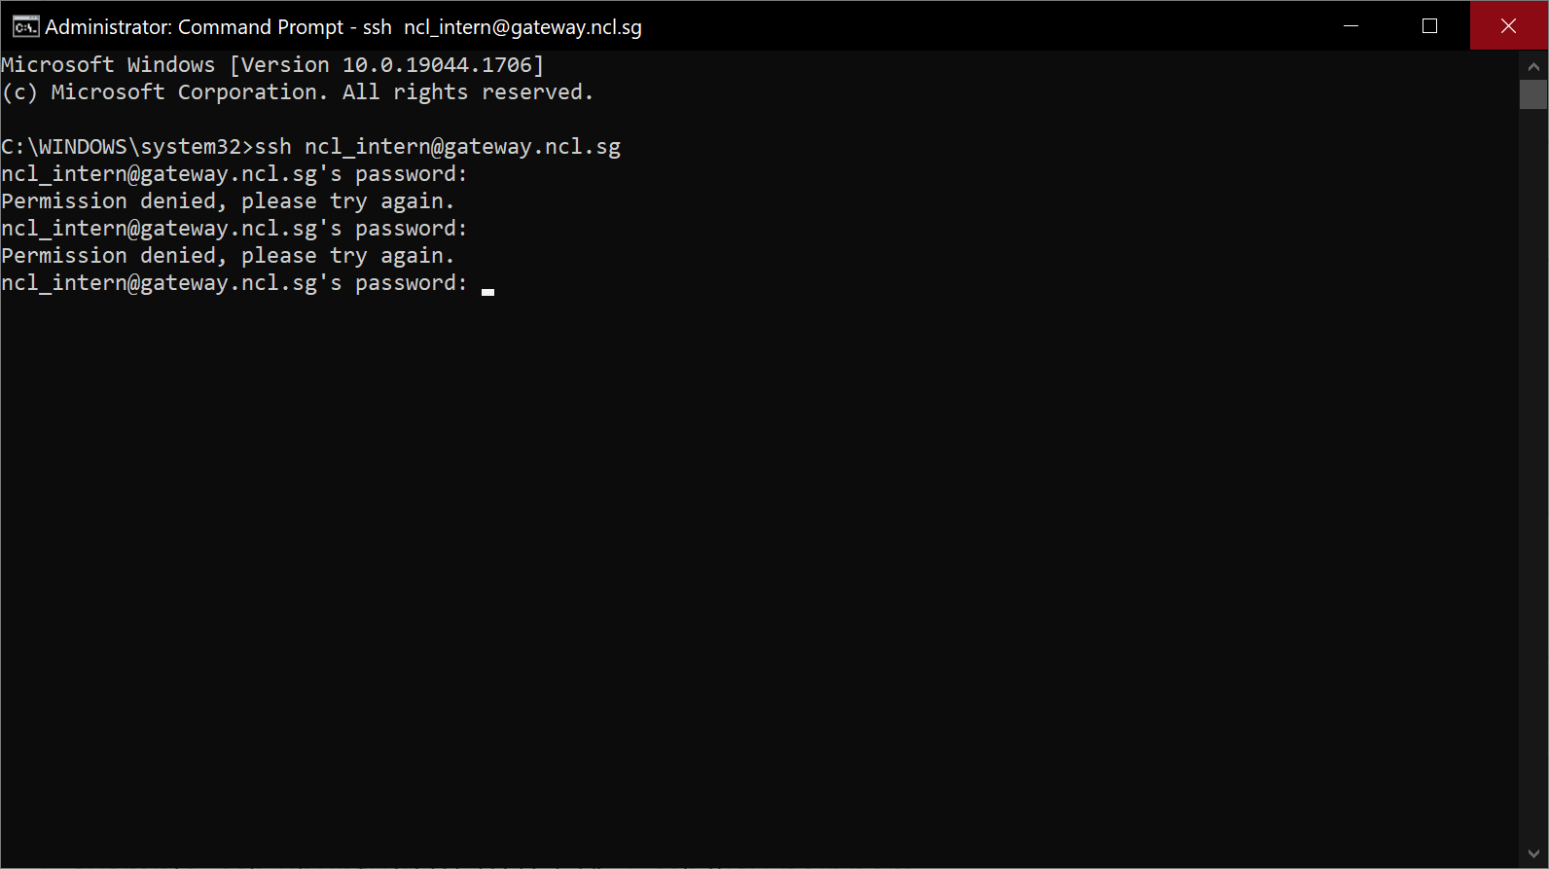
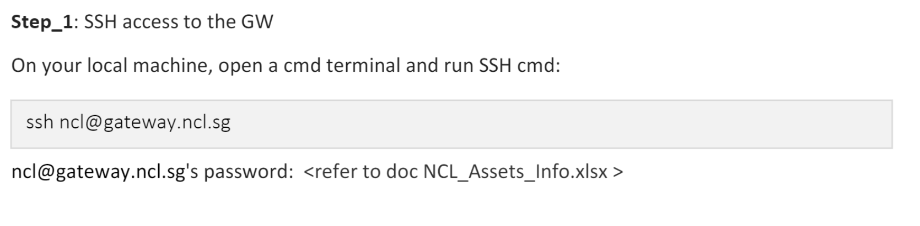
Problems Faced
Problem 1: Unable to access image via RDP
Elaboration: we don’t have the credentials to ssh into the vm remotely, and we are unable to create our own account as we do not have access to the file NCL_Assets_info.xlsx

Slide 4
Problems Faced
Problem 2: Some/most images need credentials to login in order to use the VM, we do not know the credentials required to login to the image.
Elaboration: we need to access the image in order to retrieve the specifications of the images. Not sure if the credentials are stored somewhere on the platform or there is a universal admin account

Slide 5
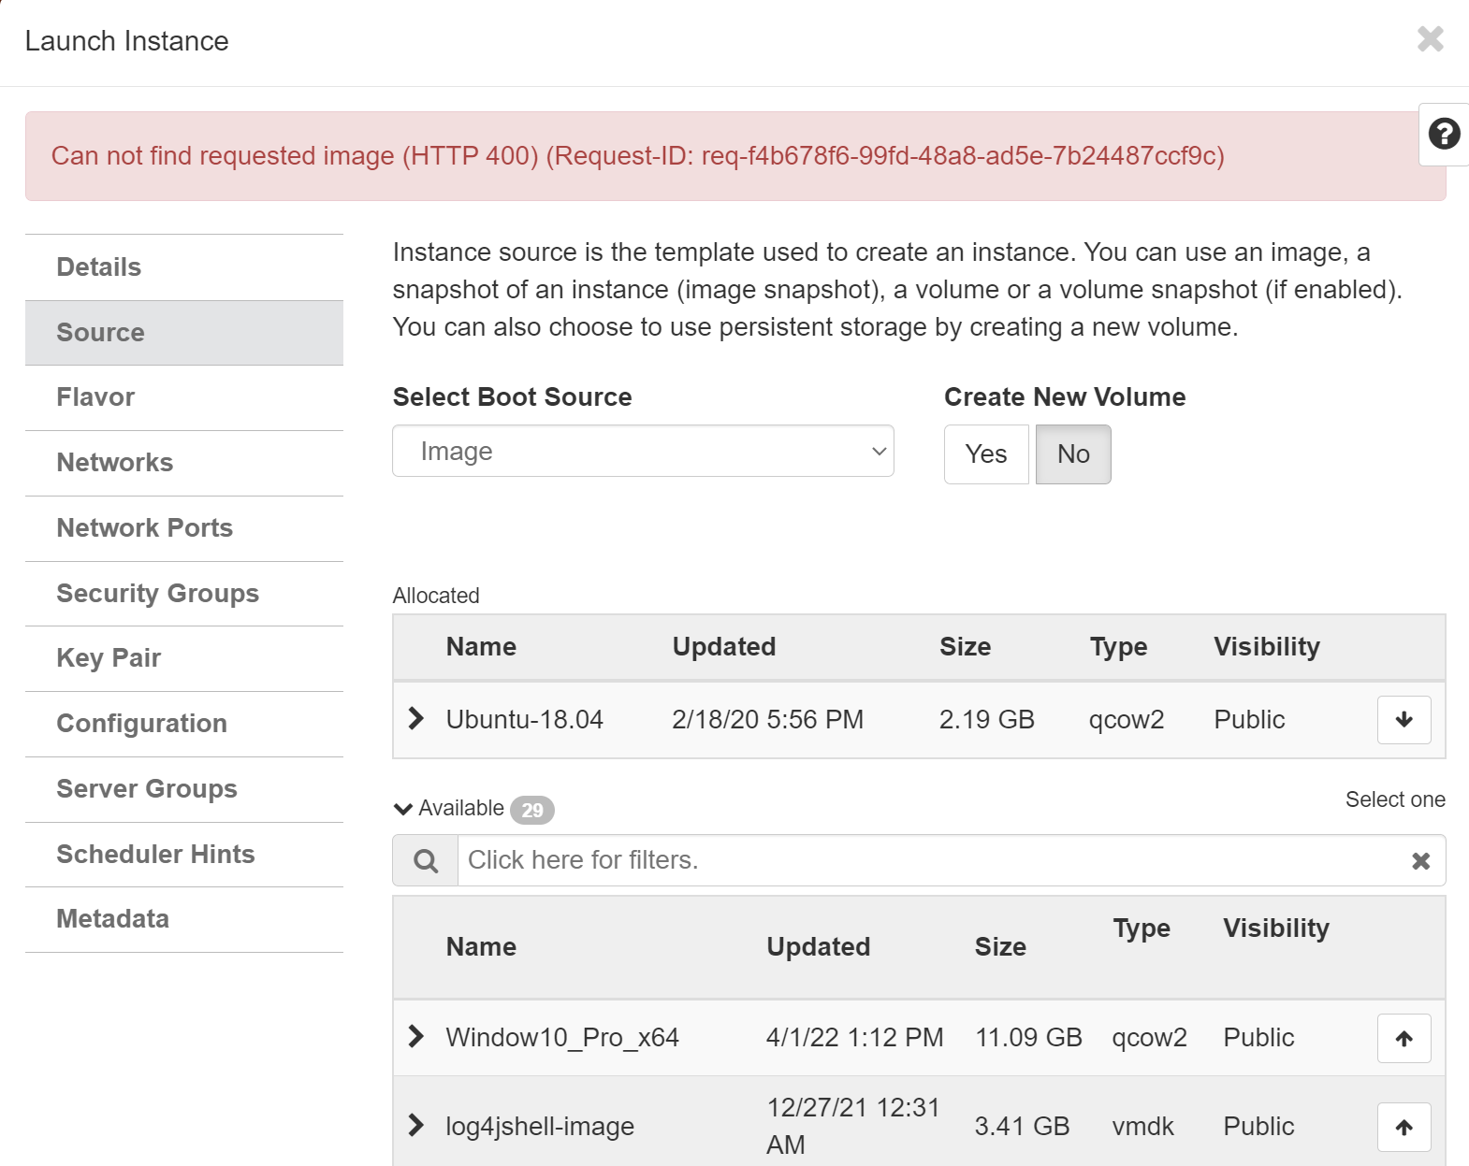
Problems Faced
Problem 3: Unable to locate image when trying to create an instance
Elaboration:

Slide 6
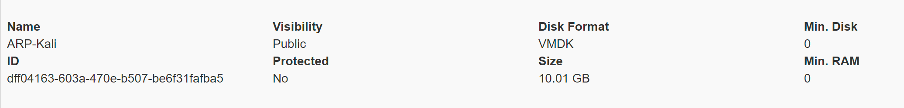
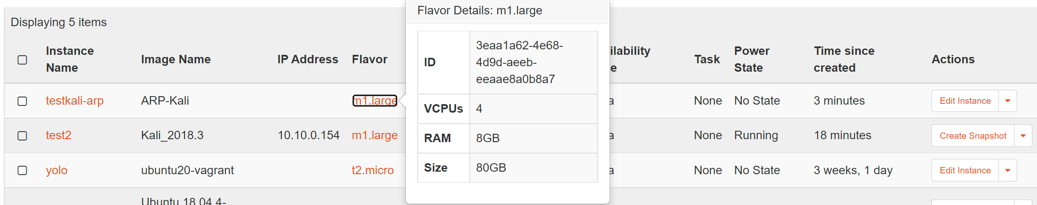
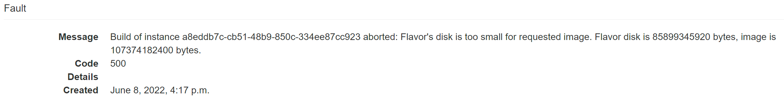
Problems Faced
Problem 4: Unable to create image even when enough resources are allocated. (Problem image: ARP-Kali)
Elaboration:

Slide 7
User Comments
1. We are able to create instances on the OpenStack platform without much issue. The problems come after the creation of the instances when we try to use the VMs. Mostly because we’re missing the credentials to login to the image.
2. Unable to connect to VM via RDP as we don’t have the necessary accounts on ssh/Jira (problem 1)
3. Some other miscellaneous problems such as missing images upon creation or flavor not having enough resources to launch the image when it should have enough resources

